Slide 1
Machine Learning Pattern Classification - Challenge
Temporal Frameworks
Sebastian Pichler & Laurin Siebert

Slide 2
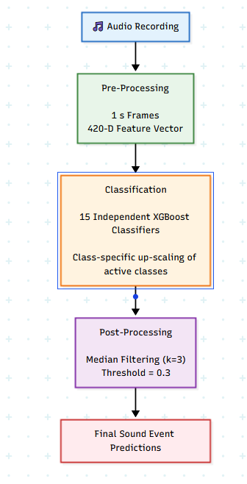
Model Architecture
Trained on 420 Feature Dimensions
Multi-label setup via independent binary classifiers
Class specific positive weighting
Temporal smoothing as post-processing via Median Filtering with a (3,1)-sized Kernel

Slide 3
Investigated Hypotheses
Event duration strongly affects detection performance
      Long stationary sounds consistently achieve highest performance
      Short trainsient sounds are averaged out in 1s windows and a median filtering with a larger kernel
Acoustic distinctiveness matters more than frequency alone
      Although light switch is a rare and short sound event using this model structure it became well detectable
Median filtering improves robustness of the prediction
      A larger Kernel size correlates with higher recall
      The sweetspot does not lose precision, but still gains robustness
      Removes isolated noise and fills gaps for sustained events

Slide 4
Conclusion Summary
XGBoost significantly outperforms the baseline
Class (specific) weighting helps rare events
Accoustic distinctiveness is more important than raw frequency
Temporal smoothing removes prediction noise

Slide 5
Limitations
Future Directions
Too large hop size / temporal resolution for short events
Confusion between similar events. E.g. door_, wardrobe_drawer_ and window_open_close
Independent classifiers ignore inter class correlations
Shorter frame hop size
Learn audio embeddings to differentiate nonlinear clusters
CRNN / Transformer based SED models
Multi-label architecture to detect co-occurence

